Slide 1
Human resources slide 1
IBM HR Analytics Employee Attrition & Performance

Slide 2
Human resources slide 2
Overview
Dataset Link: https://www.kaggle.com/datasets/pavansubhasht/ibm-hr-analytics-attrition-dataset/
Github Link: https://github.com/mennahamdy431/CODING-SAMURAI-INTERNSHIP-TASKS/tree/main/task2

Slide 3

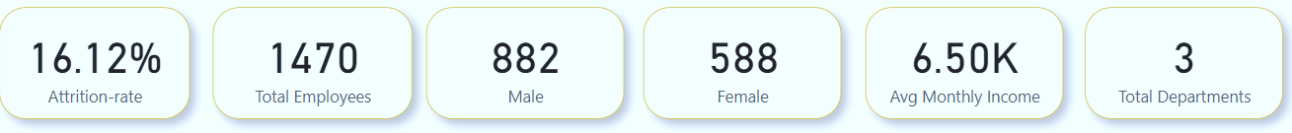
Human resources slide 3
Attrition rate = (Number of Employees Who Left) / (Total Number of Employees)
16.12%

Slide 4
Human resources slide 5
Attrition By Department:
Employees in the Research and development departments have a notably high attrition rate, indicating a need for targeted retention strategies in these areas.

Slide 5
Human resources slide 5
Attrition By Gender:
Males are more likely to depart from the company compared to females, suggesting a potential gender-based attrition pattern.

Slide 6
Human resources slide 5
Attrition By Age:
The average age of employees is 37, indicating that the younger generation shows a higher attrition rate, which might be due to career exploration or other factors.

Slide 7
Human resources slide 5
Attrition By Marital Status:
Marital status significantly affects attrition rates, with married employees being more likely to stay with the company than singles.

Slide 8
Human resources slide 5
Attrition By Business Travel:
Employees who travel rarely have a notably high attrition rate, indicating a need for targeted retention strategies in these areas.

Slide 9
Human resources slide 5
Attrition By Work Life Balance:
Employees who do not have a healthy work-life balance are more likely to leave, emphasizing the importance of promoting work-life equilibrium.

Slide 10
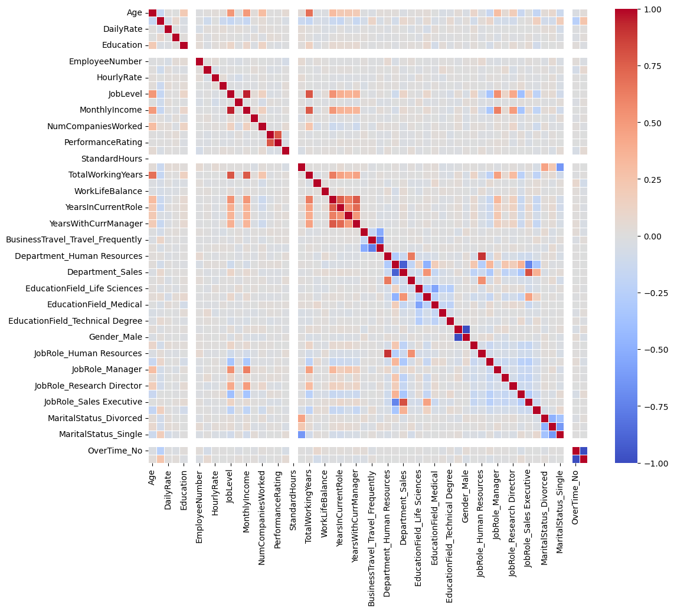
EDA

Slide 11

Human resources slide 8
Features importance
According to correation matrix, JobLevel and YearsInCurrentRole have the most significant impact on attrition.

Slide 12
Human resources slide 6
Strategies to reduce attrition:
Gender:
Promote diversity and inclusion: Ensure that the workplace is inclusive, welcoming, and free from discrimination. Implement diversity training and awareness programs.
Equal opportunities: Ensure equal opportunities for career advancement and pay, irrespective of gender.
Work-Life Balance:
Flexible work options: Promote a healthy work-life balance through flexible work arrangements, telecommuting, and the ability to adjust working hours.
Time management training: Offer workshops or training on time management to help employees prioritize their work effectively.
Age:
Career development pathways: Create clear career development plans and opportunities for all age groups. Ensure that age doesn't limit professional growth.
Mentorship programs: Establish mentorship or reverse-mentoring programs that enable knowledge sharing across generations.

Slide 13
Human resources slide 6
Strategies to reduce attrition:
Business Travel:
Travel policies: Implement transparent and employee-friendly travel policies, taking into account employees' well-being during and after business trips.
Alternatives to travel: Explore alternatives to physical travel, such as video conferencing or online collaboration tools, to reduce the frequency and stress of business trips.
Department (e.g., R&D):
Identify root causes: Conduct exit interviews and surveys to understand the specific reasons for high attrition in the R&D department.
Career growth opportunities: Create a clear career growth plan for R&D employees, with opportunities for advancement, training, and skill development.
Workload management: Address high workloads and potential burnout by redistributing tasks or hiring additional personnel.

Slide 14
Human resources slide 10
Thank You
mennahamdy431@gmail.com

